Slide 1

P peline
The Data
How do we go from data set to question?
And from question to data set?
© Jennifer Mankoff
The Data Pipeline; HCII; Spring 2014

Slide 2
Goals
After this, you should be able to:
Understand the elements of the data pipeline as they played out in a case study
Be able to point to some pitfalls where things can go wrong in the data pipeline
Be able to explain how the question being answered affects the rest of the pipeline
Adapted from http://www.fordham.edu/economics/Vinod/correl-regr.ppt

Slide 3
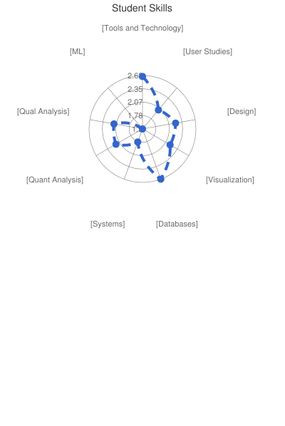
First, your profile
Majors:
linguistics
hci II
computer science II
educational technology II
business
information systems IIIIIII
computational data science
interaction design
public policy & data analytics
communication design
SEI
Some interesting past projects:
baseball analytics
student emotion via tool use
public transit usage
communicable disease
…

Slide 4
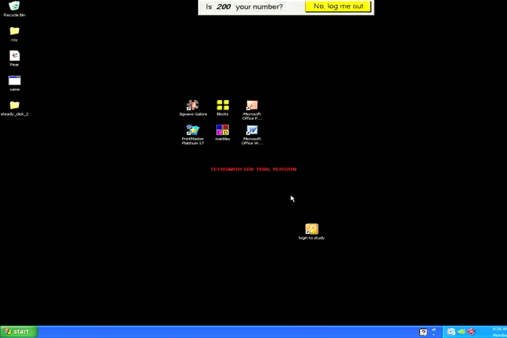
What can we do to reduce the impact of this problem?
Attempt to double-click desktop icon
Duration: 1 minute 40 seconds
Notes:
(PAUSE TO MAKE SURE VIDEOS PLAY) Here we see Annie attempting to activate a desktop icon. The video on the right shows her attempts to activate this desktop icon, and is unedited and lasts 1 minute, 40 seconds. The video on the left cycles through 3 clips that illustrate her two main pointing problems: slipping off a target (which she did 5 times) and difficulty smoothly moving the cursor making sporadic movements.
IF video doesn’t play go back to previous slide

Slide 5
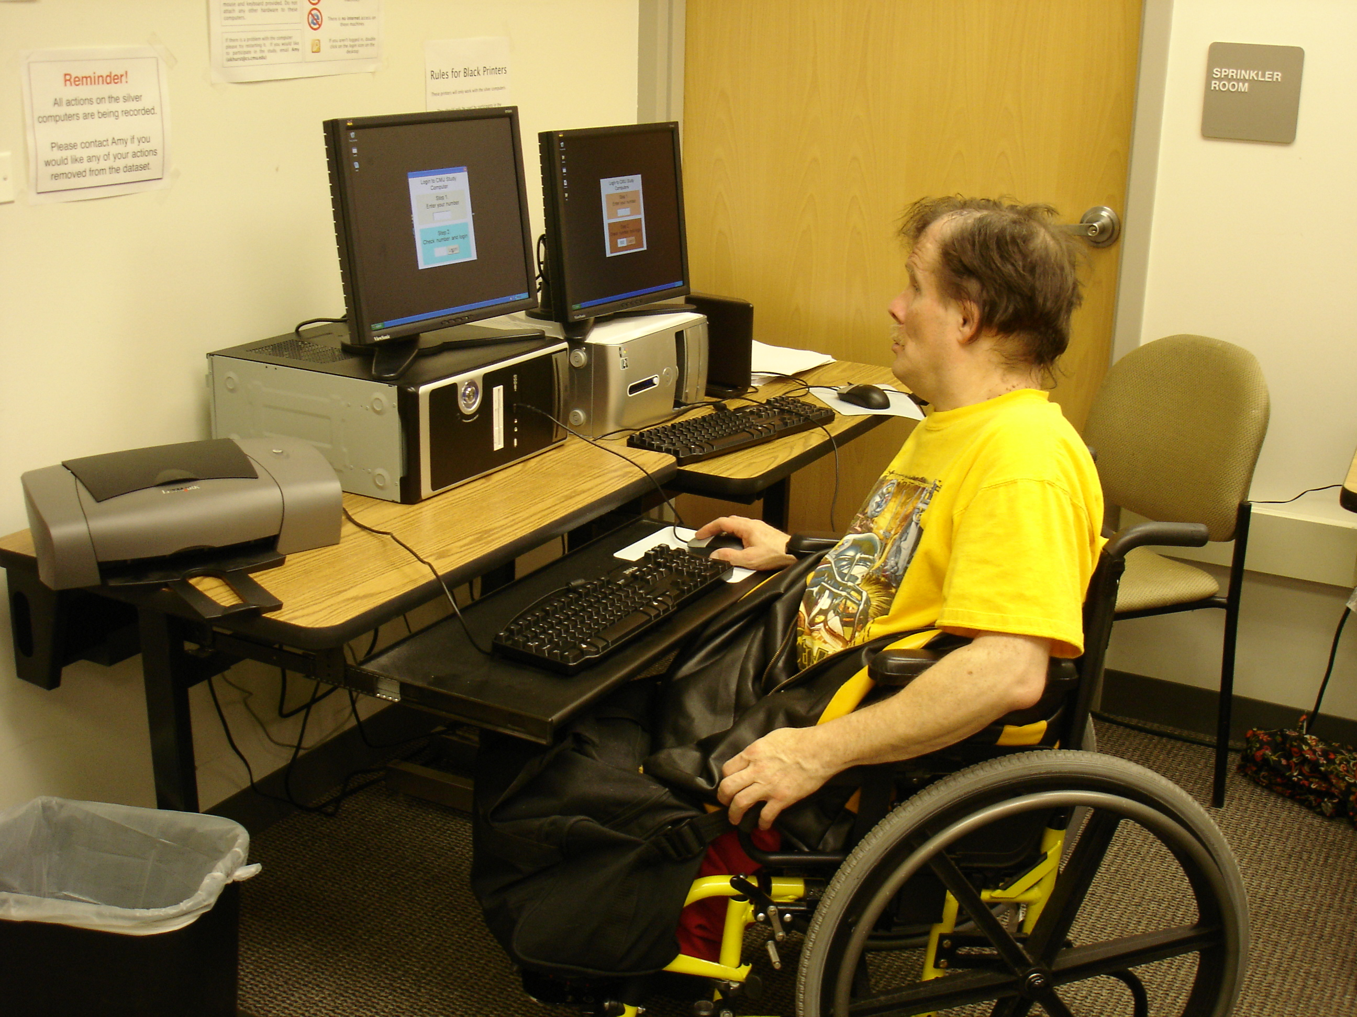
Large Real World Datasets
United Cerebral Palsy Pittsburgh
(08-10) 12 participants
Collected hundreds of hours of real world data from 27 people with and without pointing problems
Websurfing, socializing (email, instant messaging, social networking websites), homework, and video games
Both desktop and laptop usage
Notes:
Collected hundreds of hours of real world use from 27 people with and without pointing problems
We ran our pilot study at UCP Pittsburgh, and installed two desktop computers in a pre-existing computer lab. Participants were able to use these computers whenever they wanted (during a class or their free time) and perform any tasks they wanted. These computers are still collecting data at UCP, and for the first year of this study, they did not have internet access.
We recruited twelve participants with pointing problems due to motor and/or cognitive impairments for this pilot study

Slide 6
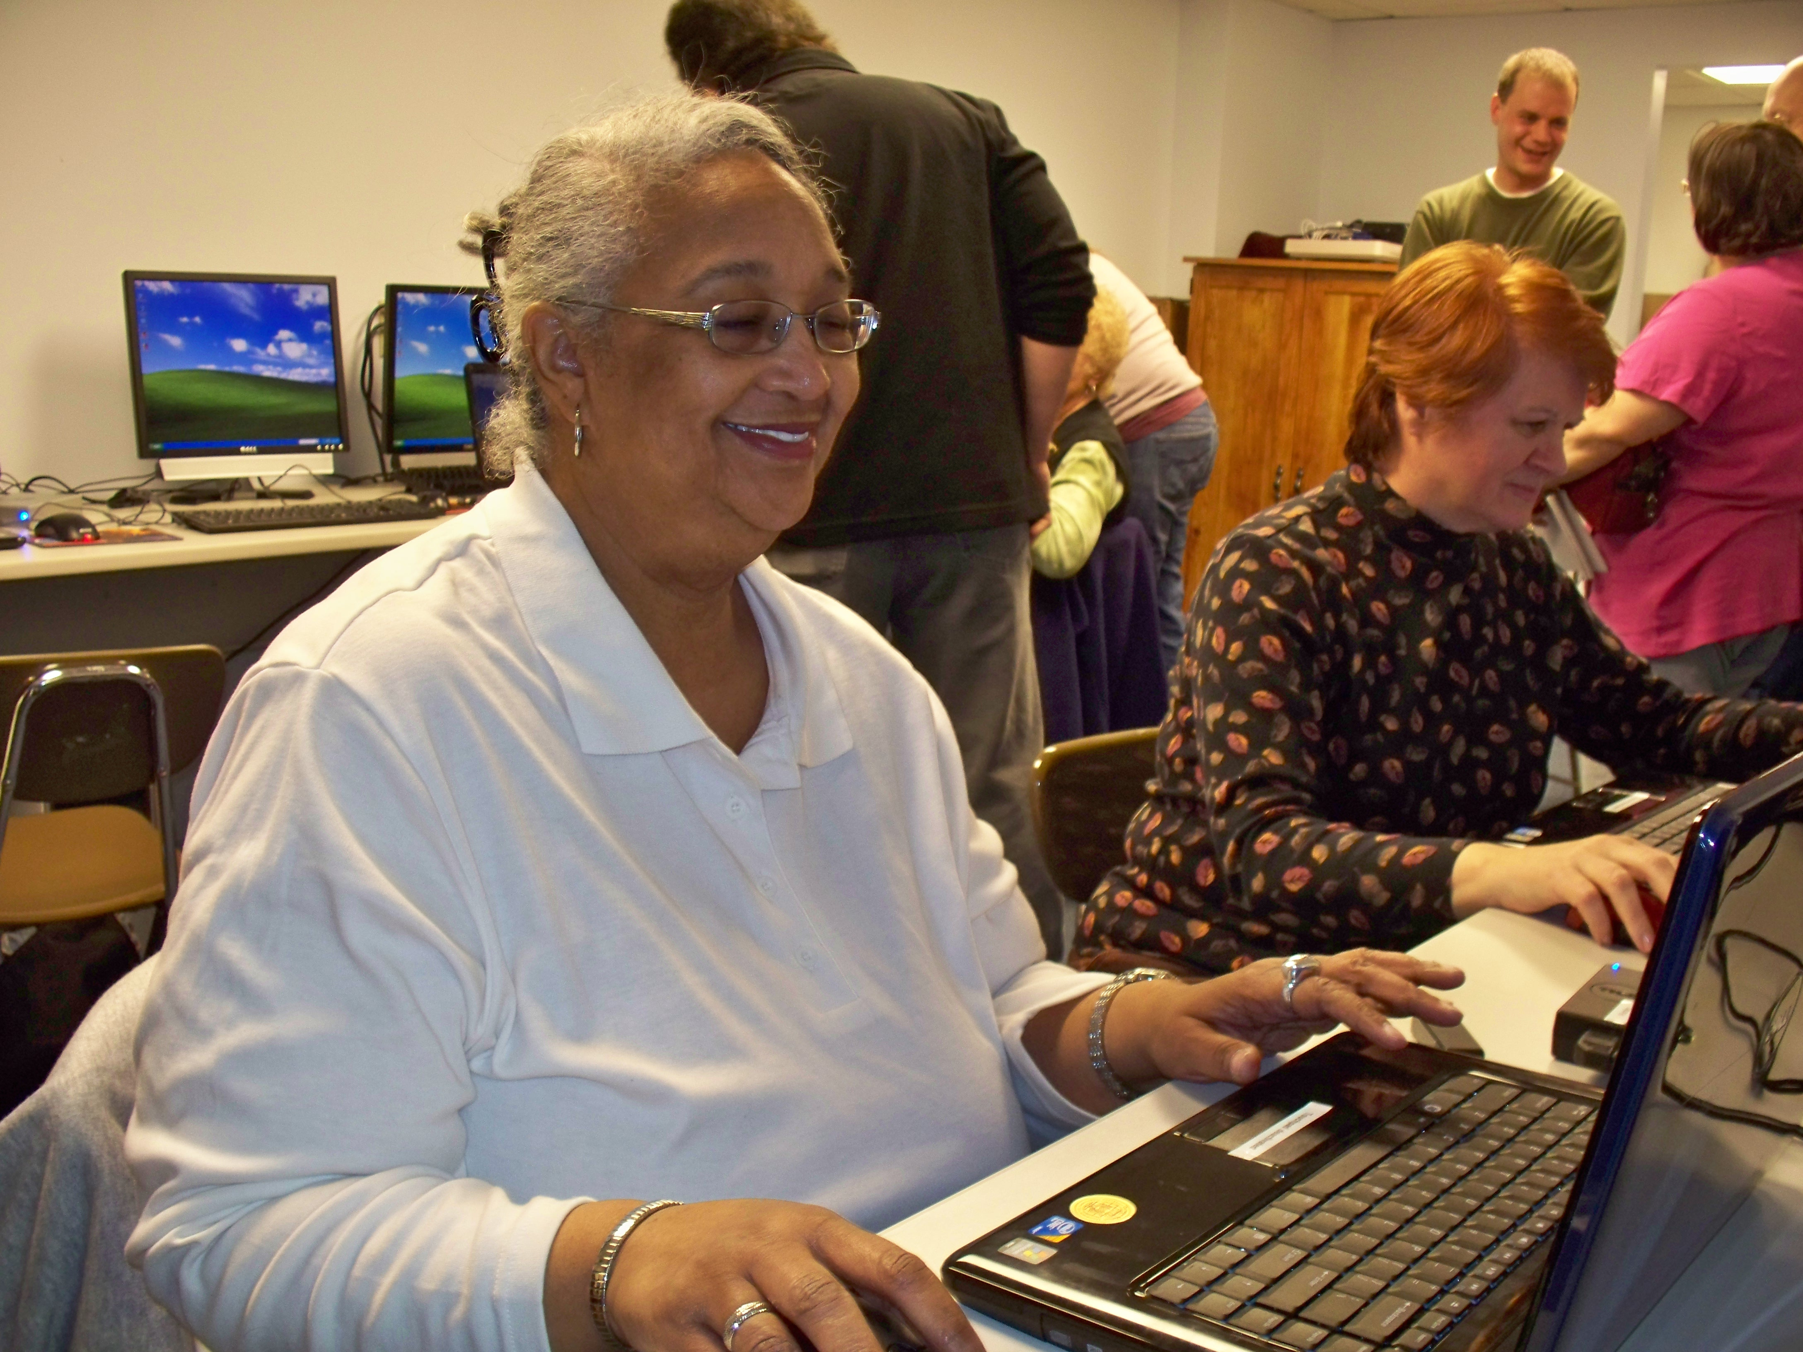
Laptop Deployment: Multiple Groups (July 09 – 10) 17 participants
 | Participants | Female | Average Age | % data collected
Able | 4 | 1 | 29.25 | 22.87%
Older Adult | 8 | 8 | 67.63 | 69.15%
Motor Impaired | 4 | 2 | 41.75 | 7.99%
Notes:
We have been collecting real world data using laptops for almost a year. In this study, we give our participants identical hardware: a DELL laptop with an external USB mouse. Participants who did not have access to the internet at home or work, received a wireless modem.
<click>
Our laptop deployment includes 4 individuals with motor impairments (2 of whom were also in our desktop study), 4 able bodied individuals (we recruited from CMU through a newsboard advertisement), and 8 older adults (a group of women who have known each other for years, are mostly computer novices, and meet monthly at Blueroof Technologies).
70% of the data we collected was from older adults – and most of this was game data (such as freecell, spider solitaire, mahjonng etc). Overall, over 50% of all data collected was from games, and 25% from Internet use.
----
Traumatic Brain Injury, occasional tremor
Cerebral Palsy, Spinal Cord Injury, Traumatic Brain Injury
Paralyzed from the waist down, memory and motor impairments (including an intermittent tremor).
Cerebral Palsy, arthritis, upper extremity impairment, cannot move right limb.

Slide 7
Our iterative process
Analysis & etc (not today’s focus)
Questions
Data Sets
New Questions
Can we characterize pointing problems?
Can we detect pointing problems?
Can we predict what technology will help?

Slide 8
Our iterative process
Analysis & etc (not today’s focus)
Questions
Data Sets
New Questions
Can we characterize pointing problems?
Year of real world data from people with & without pointing problems (and elders)
Can we detect pointing problems?
Can we predict what technology will help?
Lab data for people with and without AT

Slide 9
Our iterative process
Analysis & etc (not today’s focus)
Questions
Data Sets
New Questions
Can we characterize pointing problems?
Year of real world data from people with & without pointing problems (and elders)
Visualization of trends within & across subjects
Can we detect pointing problems?
Statistical analysis (regression)
Can we predict what technology will help?
Lab data for people with and without AT
Supervised machine learning

Slide 10
Our iterative process
Analysis & etc (not today’s focus)
Questions
Data Sets
New Questions
Can we characterize pointing problems?
Year of real world data from people with & without pointing problems (and elders)
Can we predict task switches?
Can we predict click targets?
Can we detect pointing problems?
Can we improve targeting?
Can we predict what technology will help?
Lab data for people with and without AT
Can we detect routines?

Slide 11
Real World Data Set

Slide 12
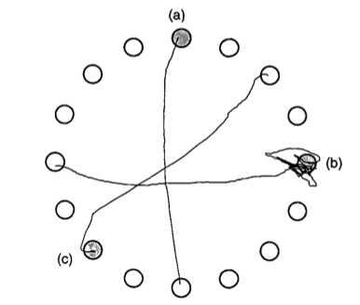
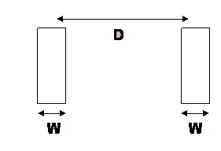
Laboratory Evaluation Limitations
Simulate real world environments
Location and equipment may be unfamiliar to participant [Coyne & Nielsen 2001]
Observation may effect performance - “Hawthorne Effect” [Mayo 1933]
Participant may become fatigued and not take necessary rest - “Demand Effect” [Orne 1962]
Tasks frequently artificial and repetitive, which may bore participants and negatively effect performance
Studying real world use removes these limitations
Notes:
To better understand why we study real world use, let’s first look at some of the limitations of laboratory evaluations. Laboratory evaluations simulate real world environments, and the constraints of the simulation can affect performance – particularly for individuals with performance problems caused by a disability.
First, the study logistics and equipment may be inconvenient, uncomfortable, or difficult for participants with disabilities. For this reason evaluations in the home and with the participant’s equipment rather than the lab have been recommended.
Additionally, the simple act of human observation may effect human performance.
The participant may become fatigued and not take necessary rest because they want to please the experimenter.
It is also possible that the participant will get bored and will rush to finish the study. Many performance tasks are susceptible to bored participants as they frequently ask individuals to perform repetitive tasks.
Most of these limitations can be alleviated by moving out a traditional laboratory setting and by studying real world use instead.
----
Too long.
We do laboratory stuff because… but it has its limitations
Automating an arduous task - CRUMBS means we don’t have to sit there.

Slide 13
Why Study Real World Use?
Captures most realistic examples of pointing problems, enabling us to build best models to assess performance
Collect large datasets from individuals with limited mobility and by letting them control study logistics
Study performance changes over time
Notes:
We study real world use because it is the best way to capture large datasets of realistic pointing. We need realistic examples to understand an individual’s range of abilities and the problems they may encounter. In general, when working with machine learning, larger datasets produce better (or more generalizable) models.
One of the reasons this approach enables us to collect large datasets from individuals with limited mobility is that we give them control over study logistics.
Another advantage to studying real world use is the ability to study changes in performance over time

Slide 14
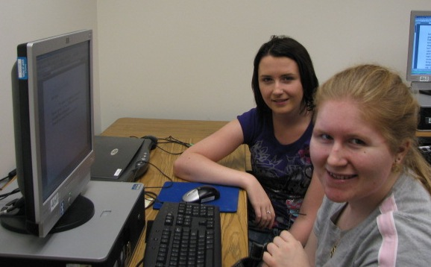
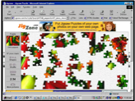
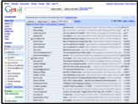
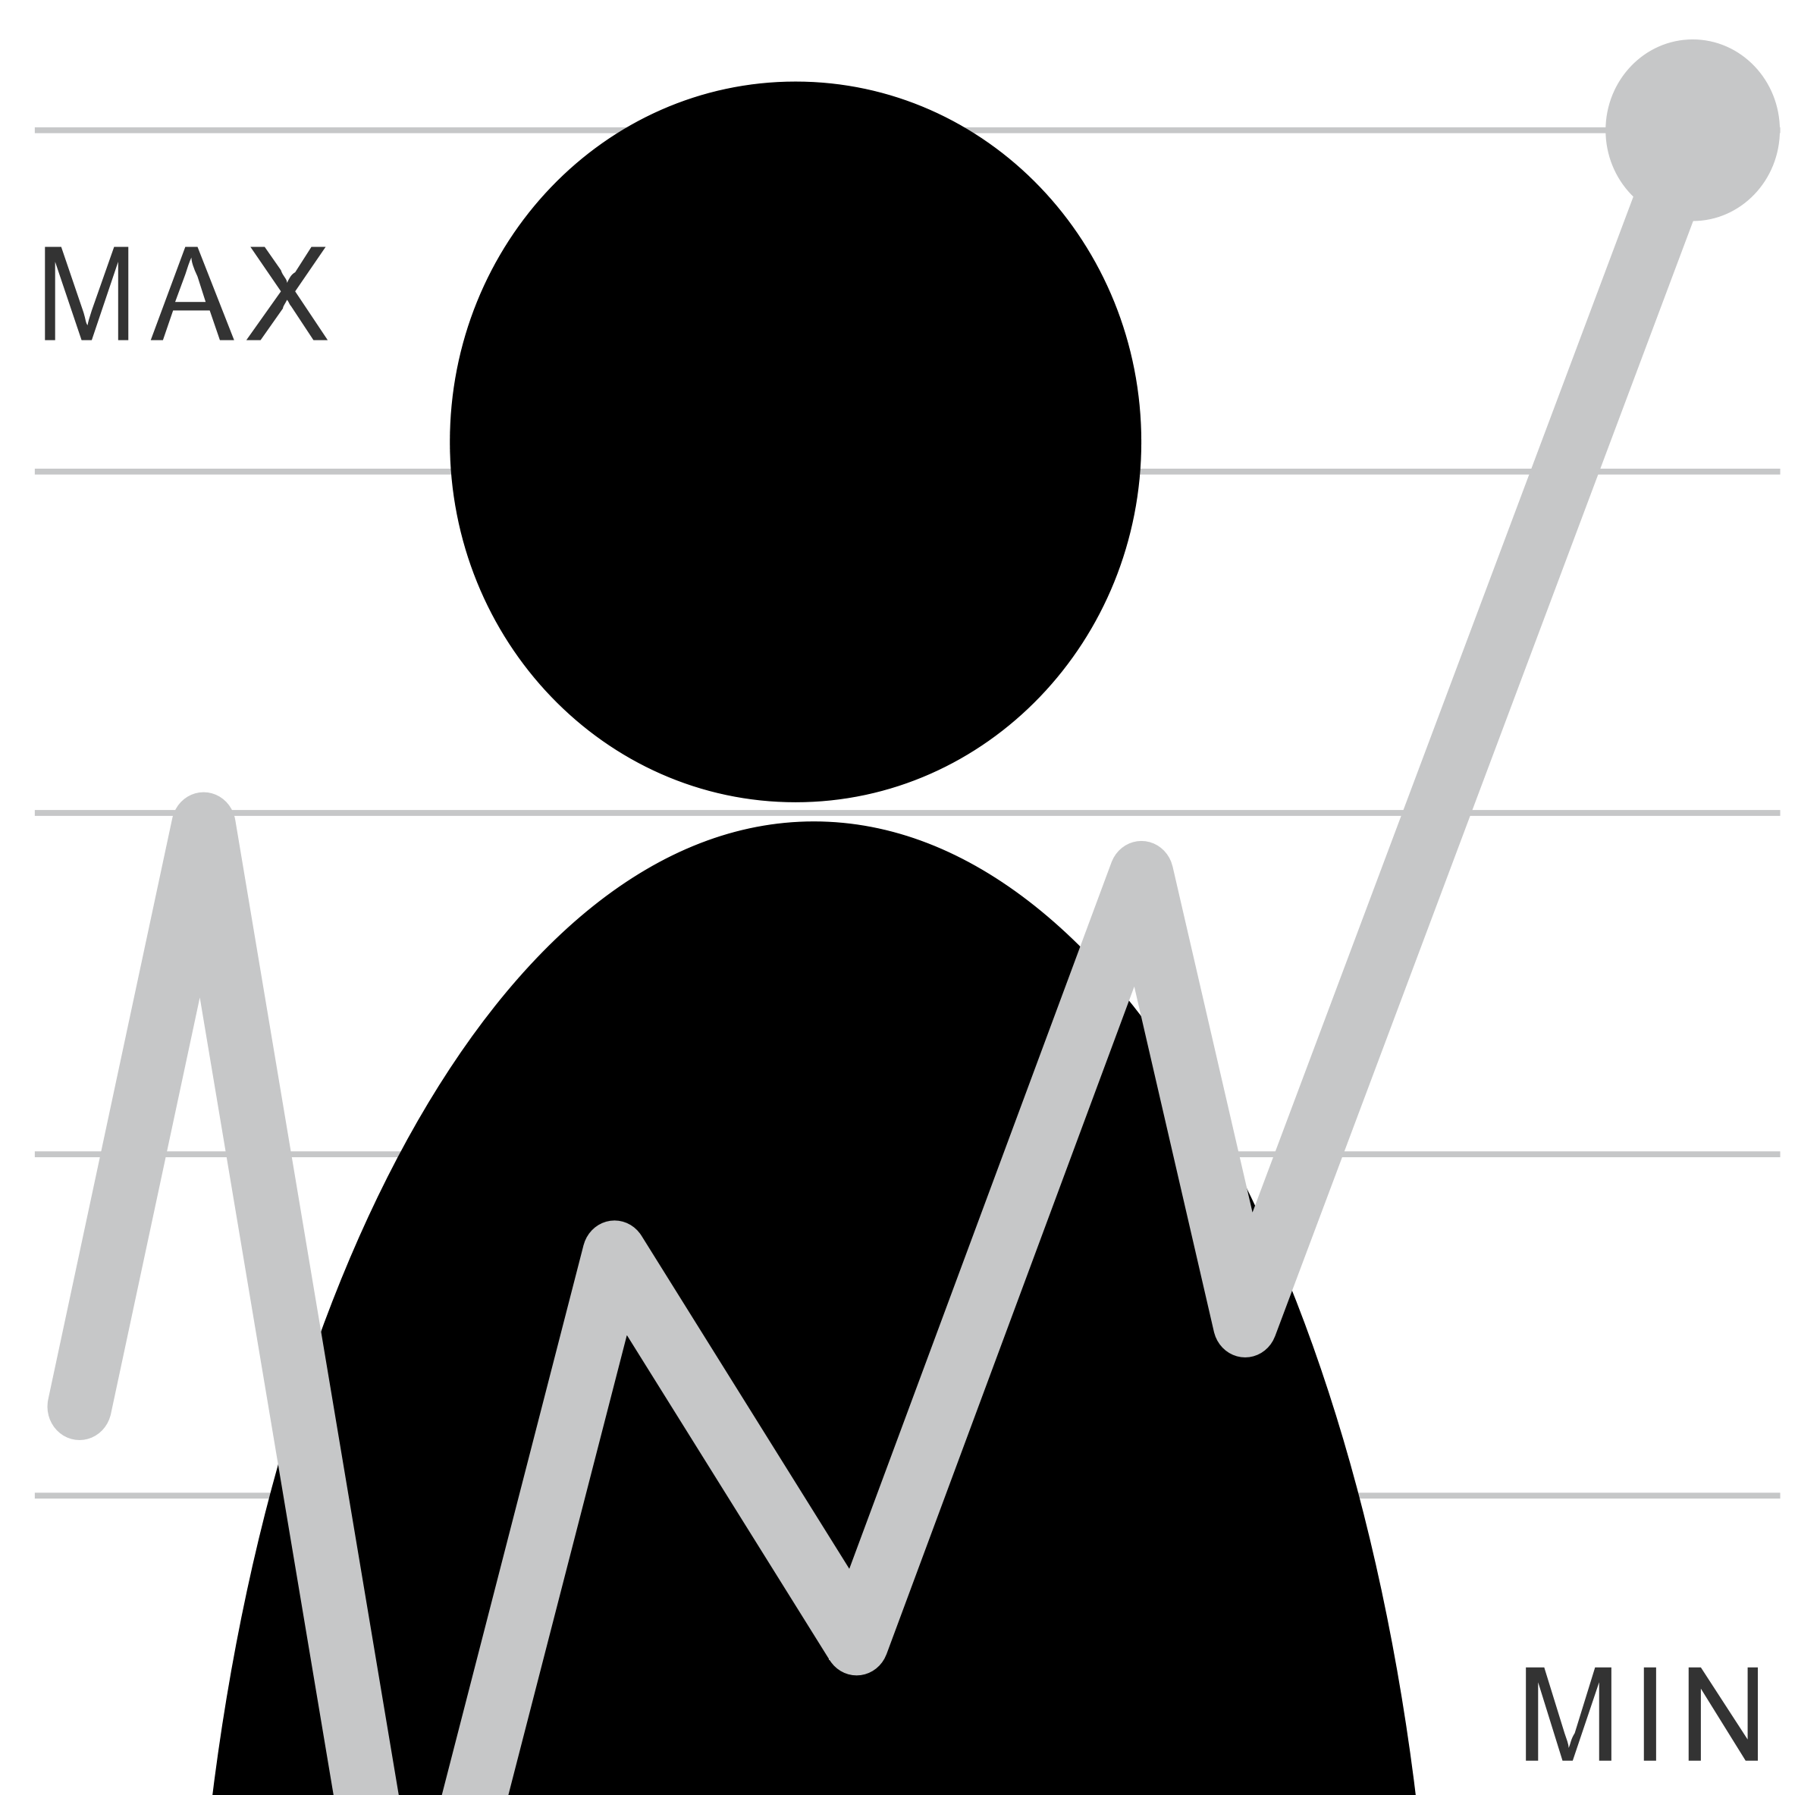
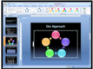
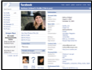
Human Issues in Data Collection
Unobtrusive logging software
Participant has full control over study logistics
Task
Collected information
Frequency and duration
Desktop and laptop use
Notes:
We use the following study design collect real world pointing data: We lend computers to our participants that run our unobtrusive logging software (will describe on the next slide). During our first meeting we perform a traditional laboratory clicking task, after that, participants have full control over all study logistics. They have the freedom to choose what they do with the computers, when the logging software is on, how frequently they use the computers, and they also get to decide the duration of any given session.

Slide 15
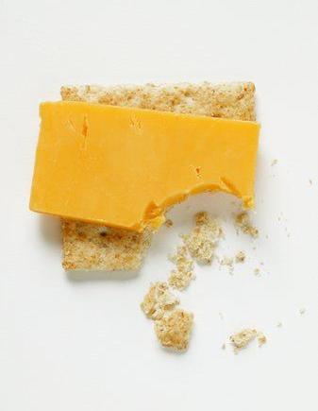
CRUMBS Logging Software
Capture Real-time User Mouse BehaviorS
Keyboard and pointer events
Window events
Target focus events from Accessibility API
Full-screen image captures on pointer events
Notes:
10 min
In order to unobtrusively capture real world pointing behavior across any application in Windows XP, we developed the CRUMBS logging software. CRUMBS captures ….

Slide 16
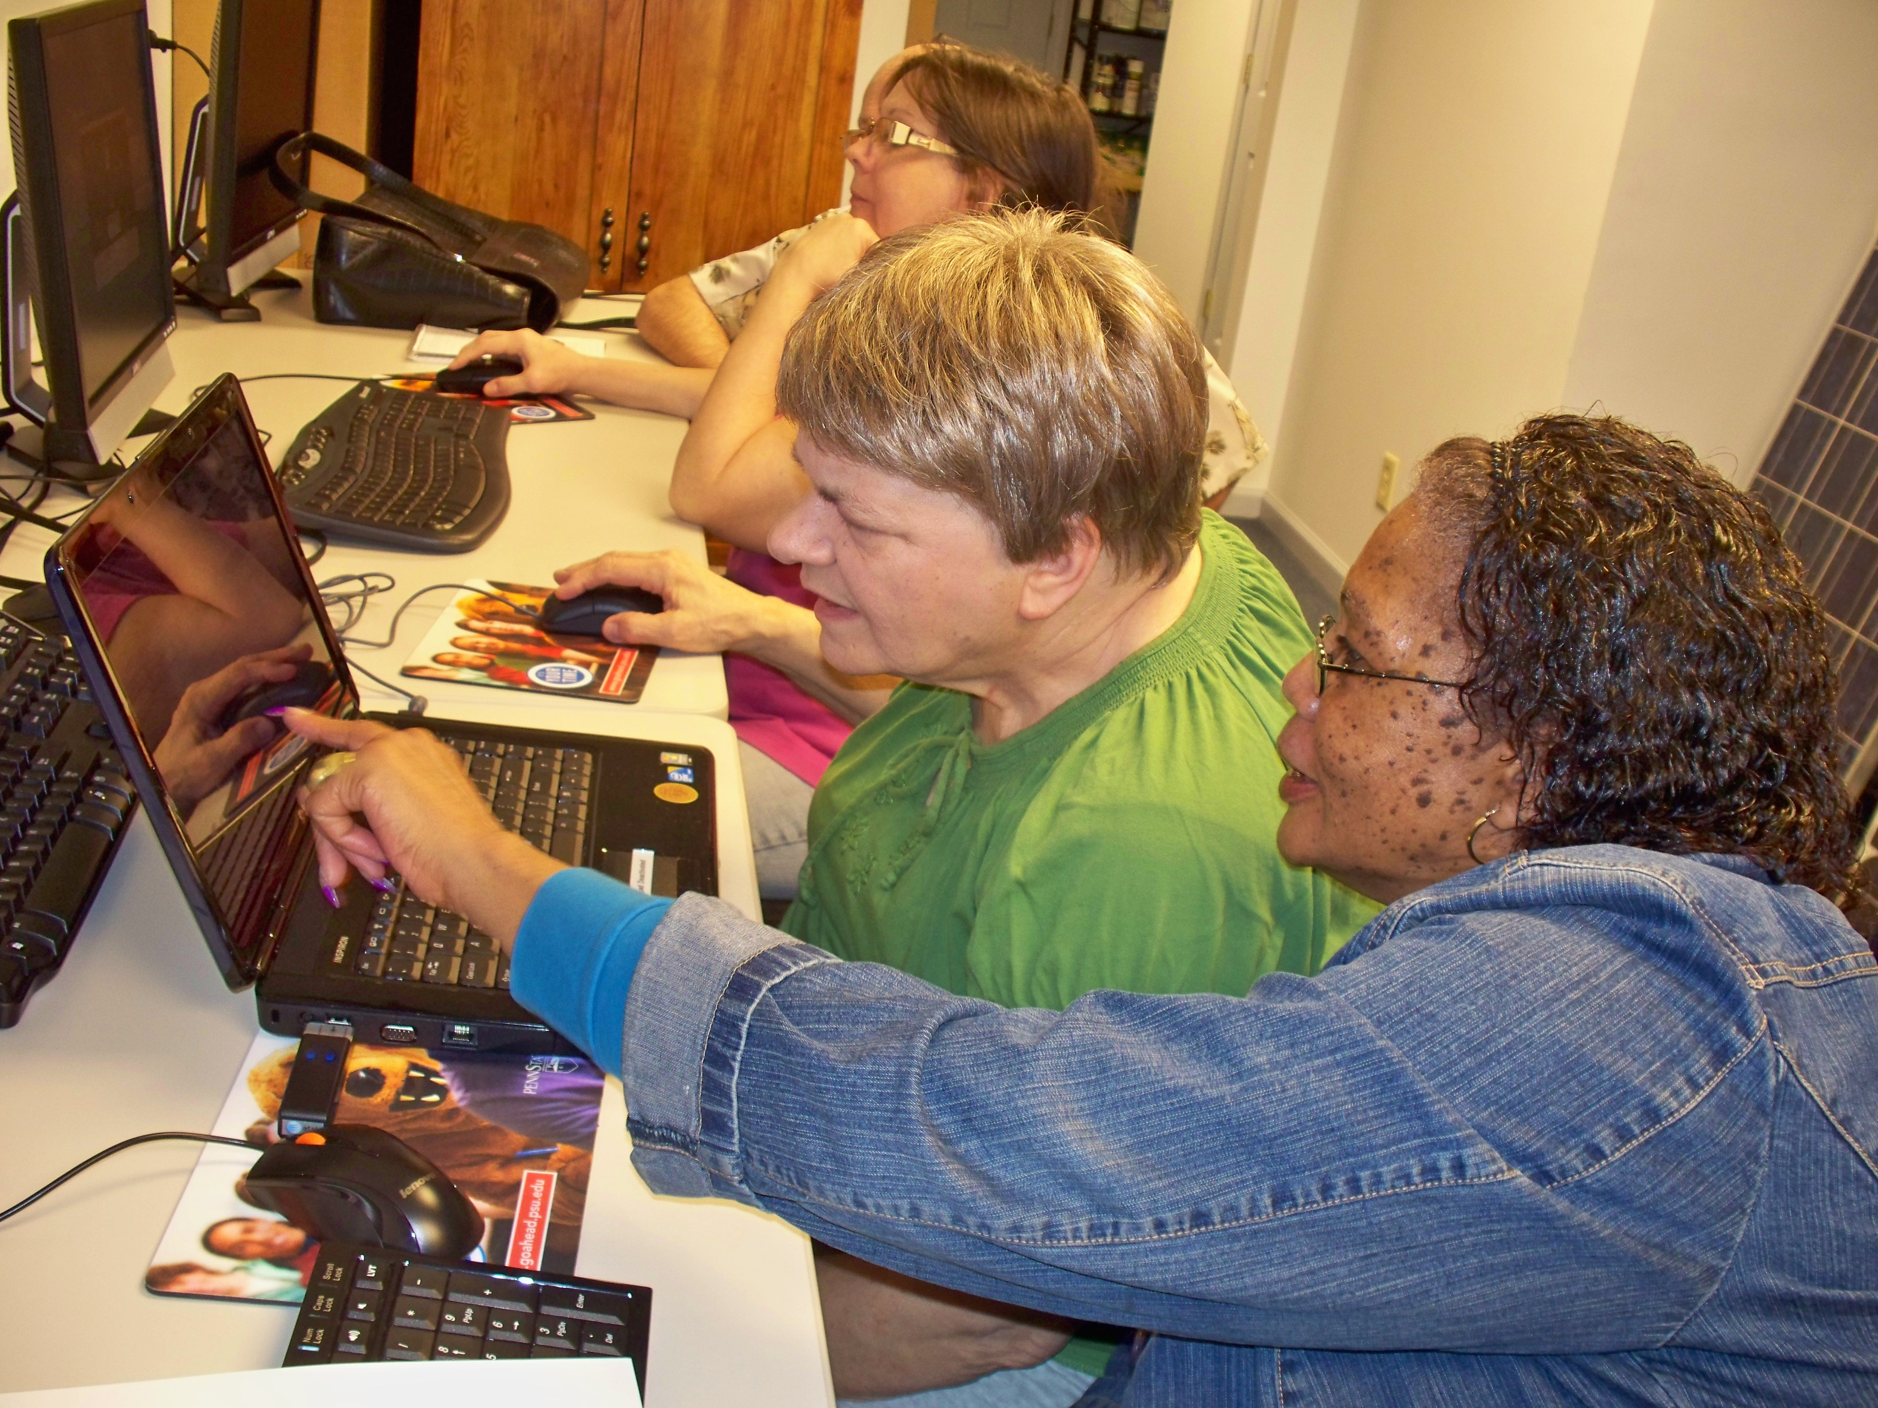
Group Support
Notes:
We found that our study protocol worked for all three populations. We believe that this protocol worked particularly well for our older adults and motor impaired participants because they had external support.
The older adults in our study frequently worked together and taught each other how to use the computers (both during their monthly meetings at Blueroof and outside these meetings).
Our motor impaired participants at UCP received support from the staff there who would help them set up the laptops, and allowed them to use their laptops during classes.

Slide 17
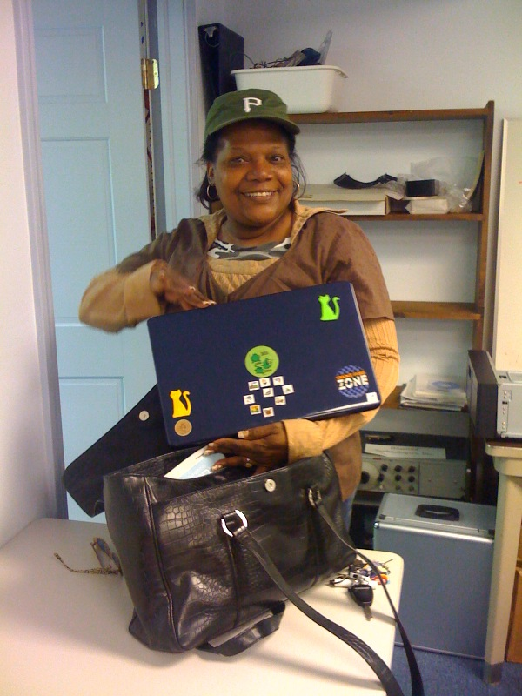
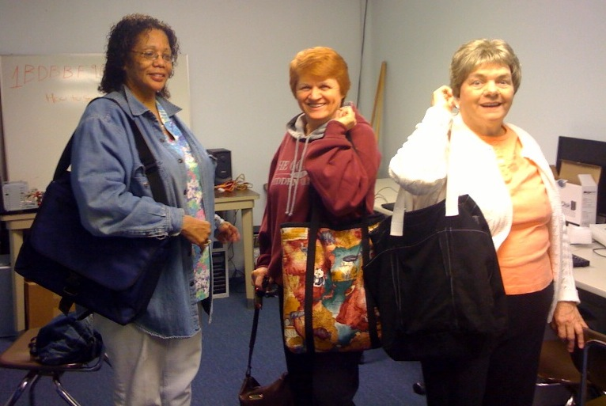
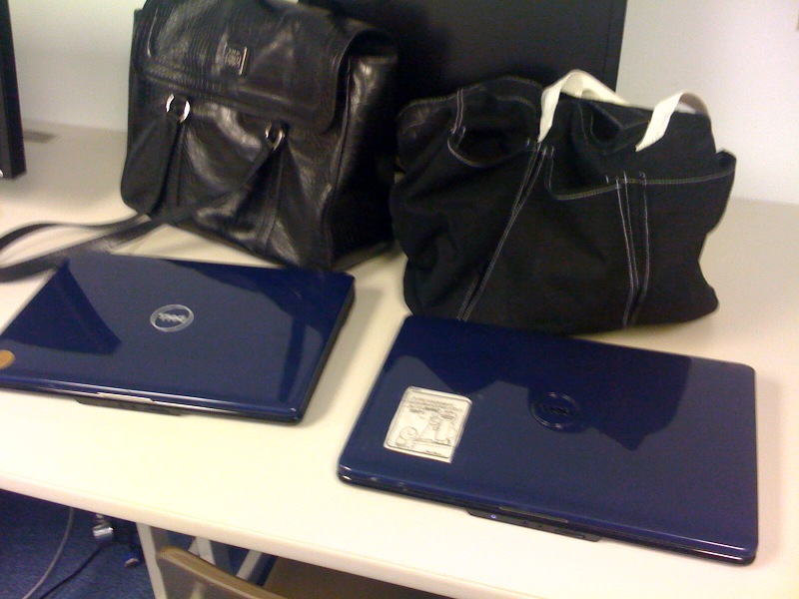
Attachment and Personalization
Notes:
In general, participants were pretty enthusiastic about being in this study – likely because they were excited to have access to a laptop. We also we found our participants used these laptops as if they were their own: they decorated them, and carried them around in unique bags.
I really enjoyed conducting this study because I got to see how much of a positive impact these laptops had on our participants lives, and watch many of our participants learn how to use computers.

Slide 18
Could we answer the first set of questions?

Slide 19
Data Tables
One-time & Qualitative data about participants (participant number; ‘diagnosis’; performance on initial test; etc.)
Session data (summary)
Event data (details)
Segment data (summary)
Keyboard key down (if any)?
Mouse features
Target features
…

Slide 20
Unlike laboratory data,
real world data is not easily segmented by task
Notes:
Analyzing real world data is more complicated than analyzing laboratory data. One reason is that laboratory log data is typically “segmented” by task (or intent) which is usually clear because the experimenter tells the participant what to do. However, when studying real world data, we do not know the user’s tasks and the only information we have to work with are long logs of event data.
Since we don’t know intent, we segment data according to events captured by CRUMBS that are relevant to the assessments we want to make. In this thesis we focus on targeting motions, so we segment data by button events and pauses.

Slide 21
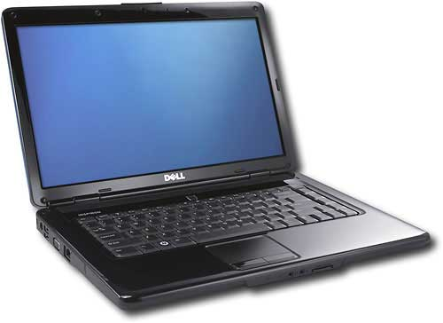
Analysis Details: Segmentation
Segmentation by clicks
Segment data by button up and down events
Segmented by movement [Chapuis et al. 2007]
Segment by button event
Analyze movement between clicks and segment by 200ms pauses
Use last segment with at least 10 pixels of movement
Investigated longer pauses, but didn’t work as well across all three groups
Notes:
We segmented this data using two techniques: segmentation by click (which we used in our pilot) and a more sophisticated segmentation technique that analyzes movement. When segmenting data by movement, we first segmented data by button events, then, we segmented the movement data between button events by 200ms pauses -- keeping the last movement that was at least 10 pixels long (so we were left with only events from that pause until the button release).
We based this 200ms segmentation technique on research by Chapuis when studying Fitts’ Law in the wild for able bodied users, but we also investigated longer cutoffs.
We found that longer cutoffs for able bodied users incorrectly included more samples that were non-targeting motions such as moving the cursor to refresh the screen. A single segmentation threshold for our older adult and motor impaired participants was less clear. The 200ms cutoff worked for most of them, however a few participants in these groups may have needed a longer cutoff.
While we feel that these cutoffs worked well in our data, this is an important problem for real world analysis, and much more investigation is required to determine optimal segmentation cutoffs (and if they should be individual or group).
Given that there were so many pauses in our data, we felt that segmenting by movement best described our data for assessment. The next few slides describe metrics we calculated to understand performance differences across groups and use this more sophisticated segmentation technique. We include metrics calculated by both segmentation techniques in our automatic assessments (which we discuss in the next section).

Slide 22
Also there are lots of anomalies
Notes:
Removed samples with more than 10 minutes of pause data
Removed windows and targets that were larger than 2000 pixels

Slide 23
And unexpected differences that made analysis difficult
Notes:
Application popularity differed a lot from group to group

Slide 24
Carefully chosen metrics helped
Do the velocity values match your understanding of the units?
Do they match past work? Keates (2005): Able ~112; Older 271; Motor 316
 | Game |  | Internet |  | MS Office
 | Mean (ms) | SD | Mean (ms) | SD | Mean (ms) | SD
Able |  |  | 147.236 | 15.912 | 128.526 | 10.1733
Older | 226.845 | 72.801 | 221.076 | 63.239 | 163.282 | 30.4858
UCP | 406.756 | 285.245 | 391.059 | 128.410 | 290.252 | 74.4451
Notes:
Example scripts to address each of these?
147 ms = .147 s

Slide 25
Carefully chosen metrics helped
Clicking, targeting, and movement metrics quantify pointing performance
Metrics drawn from previous laboratory evaluations of pointing data
ISO Ergonomic requirements for office work with visual display terminal 1998
Mackenzie et al. 2001
Ketcham et al. 2001
Keates et al. 2002 and Keates et al. 2005
Trewin et al. 2006
Notes:
Once data has been segmented, we can calculate performance metrics – which quantify the pointing action. Examples of metrics I calculate include movement velocity, number of direction changes during movement, and distance slipped during a button press.
There are literally decades of HCI studies of pointing behavior in the lab, and many metrics have been developed to measure different aspects of motion. In our analysis, we chose to investigate metrics that had been previously used in laboratory studies to measure clicking and movement problems of older adults and individuals with motor impairments.

Slide 26
Characterizing Performance: Slipping
Notes:
User unintentionally moves cursor while button is pressed [Trewin et al. 2006]

Slide 27
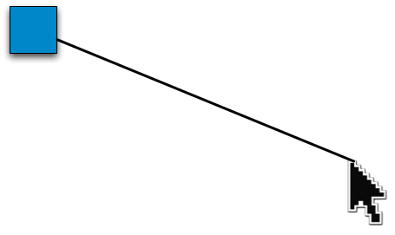
Movement: Efficiency
[ASSETS 2008]
Was the movement efficient?
Excess distance travelled [Keates et al. 2002]
Count direction changes [MacKenzie et al. 2001]
VS
Notes:
We can also evaluate performance by investigating the trajectory of pointer movement. Two measures I look at are the excess distance travelled (by comparing the actual distance travelled to the optimal path); and the number of direction changes (in both dimensions).
---

Slide 28
Movement: Direction Changes
[ASSETS 2008]
Notes:
When looking at efficiency of movement, we observed that some participants had highly variable movement. These graphs show the mean number of X (top) and Y direction changes (bottom) across sessions, and illustrate this variance.
--
Tasks: clicking games, MS office, Card games.

Slide 29
Difficulty of Selected Targets
Index of Difficulty (ID) in Internet and Microsoft Office use [MacKenzie and Buxton 1992]
Able
Older Adult
Motor Impaired
Notes:
CRUMBS uses the MSAA API to get information about the targets users selected during real world use. Unfortunately this API was not able to identify most of the targets in game use (I will talk more about this in a later section), so all analysis using target sizes was done only with Internet and Microsoft Office data.
In these applications, we did not find a significant difference in the size of targets selected across our three groups, but we did find significant difference in the Index of Difficulty (a measure of how difficult a movement to a target was (MacKenzie and Buxton 1992). Overall, we found that ID for motor impaired participants were significantly smaller than the IDs for able bodied participants. Smaller IDs represent easier movements either because the target is large or nearby. Likewise, larger IDs represent targets that are harder to reach because they are either far away or small.
-----
Q: entirely possible that these smaller IDs are b/c participants would move part way and then take a break (pause) so our segmentation is the reason for this. Also possible that MI didn’t travel as far or click on targets that were as small.

Slide 30
Characterizing Performance: Velocity
Notes:
User unintentionally moves cursor while button is pressed [Trewin et al. 2006]

Slide 31
Characterizing Performance: Throughput
Movement speed, independent of target size and distance to target [ISO 9241-9 1998]
Notes:
Throughput, or Index of Performance, is a common metric that describes movement speed, independent of target size and distance to the target.
Generally speaking, movement time should increase as index of difficulty increases (i.e. it should take individuals longer to reach harder targets than easy ones). Throughput is computed by dividing the Index of Difficulty (ID) by movement time to a target.
Able bodied participants had higher throughput than motor impaired participants. This means that able bodied participants were moving the fastest for any given target size. Additionally, our regression analysis showed that there was a main effect for application across group, where participants had higher throughput during MS office use than Internet use.
============
This is the only performance metric in the ISO for “Ergonomic design for office work with visual display terminals” (which is often used as a standard to evaluate pointing devices).

Slide 32
Summary of Laptop Findings
Motor impaired had “lowest” performance and able bodied had “highest” performance
Slipping frequency, click duration, X and Y direction changes (by ID), velocity and peak velocity
Games popular for older adults and motor impaired participants
These participants had shorter click duration and higher velocity and peak velocity during games than other tasks
Notes:
To summarize our laptop findings:
We found that motor impaired participants had “lowest” performance and able bodied participants had the “highest” across the following features. These findings are consistent with prior work.
We don’t know exactly why older adults and motor impaired participants showed better performance during game play. This may be due to higher motivation, engagement, or confidence about the next action.

Slide 33
Our iterative process
Questions
Data Sets
Can we characterize pointing problems?
Year of real world data from people with & without pointing problems (and elders)
Can we detect pointing problems?
Can we predict what technology will help?
Lab data for people with and without AT

Slide 34
Our iterative process
Questions
Data Sets
✔
Can we characterize pointing problems?
Year of real world data from people with & without pointing problems (and elders)
Can we detect pointing problems?
Can we predict what technology will help?
Lab data for people with and without AT

Slide 35
Detecting Pointing Problems
Limited to Office and Internet data (common to all groups)
Generated 77 features
Pointer features: clicking and movement
Target sizes
Keyboard and window event features
Two-level predictive model distinguishes between groups @ ~90-92% accuracy
Able bodied (AB) (few pointing problems)
Older adults (OA) and participants with motor impairments (MI) (more pointing problems)
Notes:
We used our real world data from our laptop deployment to assess real world use.
We used Internet and Microsoft office data to build predictive models that distinguished between two performance groups: able bodied participants, and motor impaired and older adults. We distinguish between these groups using a two level model where the first level is a two way classifier between these two groups, and makes a prediction based on one motion sample. The second level uses a windowed average to make predictions over a series of samples.
These predictive models were built using only Internet and Microsoft Office data (because CRUMBS was unable to retrieve the size and location of many of the targets in games). Using this data we generated over 70 features (using both click and pause segmentation techniques)…

Slide 36
Level 2: Windowed Results
Notes:
The first level of our classifier predicted which group performed a given movement sample. The second level of our classifier aggregated successive predictions over several movements. This is known as a “sliding window”.
Are you convinced? We’ll talk later about issues with this – from the machine learning to the fact that we had such a simplistic cut to the lack of a real world deployment
Specifically, we aggregated predictions from a variety of window sizes (1, 5,10, 20, 40, 80,160, 320 samples) and used a voting model to classify predictions of able-bodied vs. OA or MI use.
Using this sliding window increased accuracy by 5% with a window size of 5. As we increased the window size, we got better estimates. Given that we are studying real world use, it is relatively easy for us to collect dozens or hundreds of examples of use to use for these windows.
Note that as we increase our window size, we require more samples before we can make our first prediction. Additionally, there is a diminishing returns effect where adding more samples provides a smaller improvement to accuracy.

Slide 37
Our iterative process
Questions
Data Sets
✔
Can we characterize pointing problems?
Year of real world data from people with & without pointing problems (and elders)
?
Can we detect pointing problems?
Can we predict what technology will help?
Lab data for people with and without AT
Notes:
Are you

Slide 38
Predicting Demographics
[IUI 2008]
Predictions using single session of laboratory data
[Koester et al. 2005]
Individuals without pointing problems
Individuals with pointing problems
Classifier accuracy: 94.5% accuracy (Kappa = .89)
[Keates et al. 2005]
Young Adult and Adult
Older Adults
Individuals with Parkinson’s Disease
Classifier accuracy: 91.6% (Kappa = .85)
Notes:
we used these features to build classifiers that were able to distinguish between pointing performance from several groups. We used the Koester dataset to build a classifier to distinguish between performance from motor impaired and able bodied users.
We used the Keates dataset to build a 3-way classifier that distinguished between three groups of users: one of able bodied young adults and adults, a group of older adults, and individuals with Parkinson’s Disease.
---------------------------------
Koester features: Total time to complete the action, number of clicks that occurred during the action, number of times the cursor entered the target.
Keates features: Total time to complete trial, Total amount of time mouse button was pressed, Peak acceleration Count of pauses lasting 24 milliseconds or less

Slide 39
Predicting Appropriate Adaptation
Predicted need for steady clicks adaptation
Laboratory data with and without adaptation [Trewin et al. 2006]
Participants with and without pointing problems
Correctly predicted need for adaptation for 17 of 18 participants (94.4% accuracy)
Notes:
The machine learning I have presented on our real world data distinguishes between groups of performers, however the next step is to automatically detect different types of pointing problems. We have begun this investigation with a dataset collected by Trewin which examined performance with and without an assistive adaptation.
We used this data to investigate the feasibility of predicting if an individual's pointing performance will improve with a specific adaptation, from examples of their performance without that adaptation. To do this, we used a dataset collected by Trewin which had users perform the same tasks with and without Steady Clicks (an adaptation that temporarily disables drags to prevent slipping errors). Our classifier was able to correctly predict if the adaptation was needed for 17 of 18 participants.
Unfortunately, we weren’t able to do this kind of assessment from our real world data because it was all unadapted use. However, it would be possible to learn what adaptations would benefit a participant by automatically enabling them, and then comparing performance with and without them to predict if they would help a participant.

Slide 40
Our iterative process
Questions
Data Sets
✔
Can we characterize pointing problems?
Year of real world data from people with & without pointing problems (and elders)
?
Can we detect pointing problems?
Can we predict what technology will help?
Lab data for people with and without AT
✔
Notes:
Are you

Slide 41
New Questions?

Slide 42
New Questions
Questions
Data Sets
New Questions
✔
Can we characterize pointing problems?
Year of real world data from people with & without pointing problems (and elders)
Can we predict task switches?
Can we predict click targets?
?
Can we detect pointing problems?
Can we improve targeting?
Can we predict what technology will help?
Lab data for people with and without AT
Can we detect routines?
✔
Notes:
Are you

Slide 43
New Questions
Questions
Data Sets
New Questions
✔
Can we characterize pointing problems?
Year of real world data from people with & without pointing problems (and elders)
Can we predict task switches?
Can we predict click targets?
?
Can we detect pointing problems?
Can we improve targeting?
Can we predict what technology will help?
Lab data for people with and without AT
Can we detect routines?
✔
Notes:
Are you

Slide 44
New Questions
Questions
Data Sets
New Questions
✔
Can we characterize pointing problems?
Year of real world data from people with & without pointing problems (and elders)
Can we predict task switches?
✘
Can we predict click targets?
?
Can we detect pointing problems?
Can we improve targeting?
Can we predict what technology will help?
Lab data for people with and without AT
Can we detect routines?
✔
Notes:
Are you

Slide 45
New Questions
Questions
Data Sets
New Questions
✔
Can we characterize pointing problems?
Year of real world data from people with & without pointing problems (and elders)
Can we predict task switches?
✘
Can we predict click targets?
?
Can we detect pointing problems?
Can we improve targeting?
Can we predict what technology will help?
Lab data for people with and without AT
Can we detect routines?
✔
?
Notes:
Are you

Slide 46
New Questions
Questions
Data Sets
New Questions
✔
Can we characterize pointing problems?
Year of real world data from people with & without pointing problems (and elders)
Can we predict task switches?
✘
Can we predict click targets?
✘
?
Can we detect pointing problems?
Can we improve targeting?
Can we predict what technology will help?
Lab data for people with and without AT
Can we detect routines?
✔
?
Notes:
Are you

Slide 47
User Error: Helping People with Motor Impairments
Click location not always equal to intent
Model click as PMF
Re-ran to see new outcome for 4 people
Notes:
Demonstration of broad applicability of tool.
Taking same capability, using for something new. For people who have difficulty with pointing. Pointing position doesn’t accurately reflect intent.
Treat this as a new form of uncertainty.
To test this idea, we collected 419 clicks from 4 people with motor impairments
We used our framework to determing what would happen if their input was handled probabilistically. As you can see, error drops significantly when compared to conventional input.

Slide 48
User Error: Helping People with Motor Impairments
Well we could have … but it was easier to run 4 new people on known targets! One big reason: Otherwise we didn’t have all the distractor targets.
Click location not always equal to intent
Model click as PMF
Re-ran to see new outcome for 4 people
Notes:
Demonstration of broad applicability of tool.
Taking same capability, using for something new. For people who have difficulty with pointing. Pointing position doesn’t accurately reflect intent.
Treat this as a new form of uncertainty.
To test this idea, we collected 419 clicks from 4 people with motor impairments
We used our framework to determing what would happen if their input was handled probabilistically. As you can see, error drops significantly when compared to conventional input.

Slide 49
It’s difficult to collect the right data (and to use other people’s data in ways they didn’t intend)
Questions
Data Sets
New Questions
✔
Can we characterize pointing problems?
Year of real world data from people with & without pointing problems (and elders)
Can we predict task switches?
✘
Can we predict click targets?
✘
?
✘
Can we detect pointing problems?
Can we improve targeting?
Can we predict what technology will help?
Lab data for people with and without AT
Can we detect routines?
✔
?
Notes:
Are you

Slide 50
What else could we do?
Questions
Data Sets
Better Questions
✔
✔
Can we characterize pointing problems?
Year of real world data from people with & without pointing problems (and elders)
Visualize how use changes for novice elders over the course of a year
?
✔
Can we detect pointing problems?
Characterize the aspects of popular applications that are used most/least
Can we predict what technology will help?
Lab data for people with and without AT
Predict anything? Hard without labels
?
✔
Notes:
Are you

Slide 51
Key observations
There are human aspects to collecting and understanding the data
Iteration is key
Your thoughts?

Slide 52
Exercise: Twitter
Very popular, lots of data
What questions can you ask?

Slide 53
Research Case Study: Capturing the right data
Techniques needed: Careful analysis & thought
Tools that can help: simulation & prototyping [e.g. IAT - IBM Systems Journal ‘05, Momento – CHI’07 ]
Notes:
Capturing the right thing (what people need) requires an understanding of people.. Find a behavior of interest?
What’s currently available may not be what we need – how do we bridge the gap? Machine learning? Sensors? Etc.

Slide 54

Momento [CHI’07]
Iteratively designed, usable system for situated experimentation
Quick access to real world data
Easy ways to communicate with and study users
Easy ways to connect to sensors (mobile phone, context toolkit)
Carter, Mankoff
Notes:
A sentence about what momento is : Momento: Support for Situated Ubicomp Experimentation
SUPPORTING EVAL, NOT PROTOTYPE BUILDING
Supports needfinding too
Value for deciding what to capture?
Make sure no bullet points are there on these slides that aren’t necessary for the talk (cut and paste)

Slide 55
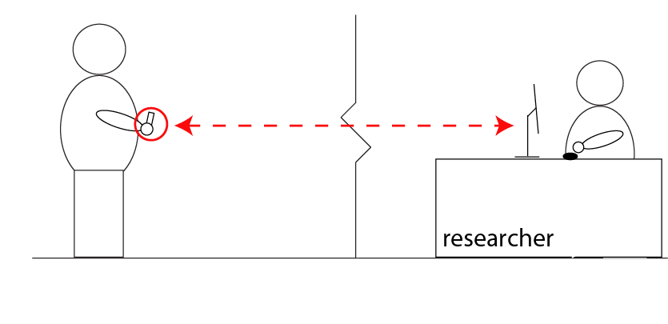
Typical experiment
SMS/MMS/XML
Experimenter
interface
Carter, Mankoff
Notes:
Fixed client also possible

Slide 56
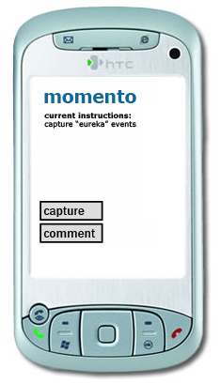
Quick access to real world data
Runs on mobile phones
No client install required
No coding required
Robust over days/weeks
Carter, Mankoff
Notes:
deploying a system that allows you to evaluate a concept (might include a rough prototype). Almost a probe --ver advanced

Slide 57
Mobile Client
Text file configuration
Study description
Capture
Audio, Bluetooth/GPS
Buttons
Remotely reconfigurable
Carter, Mankoff
Notes:
deploying a system that allows you to evaluate a concept (might include a rough prototype). Almost a probe --ver advanced

Slide 58
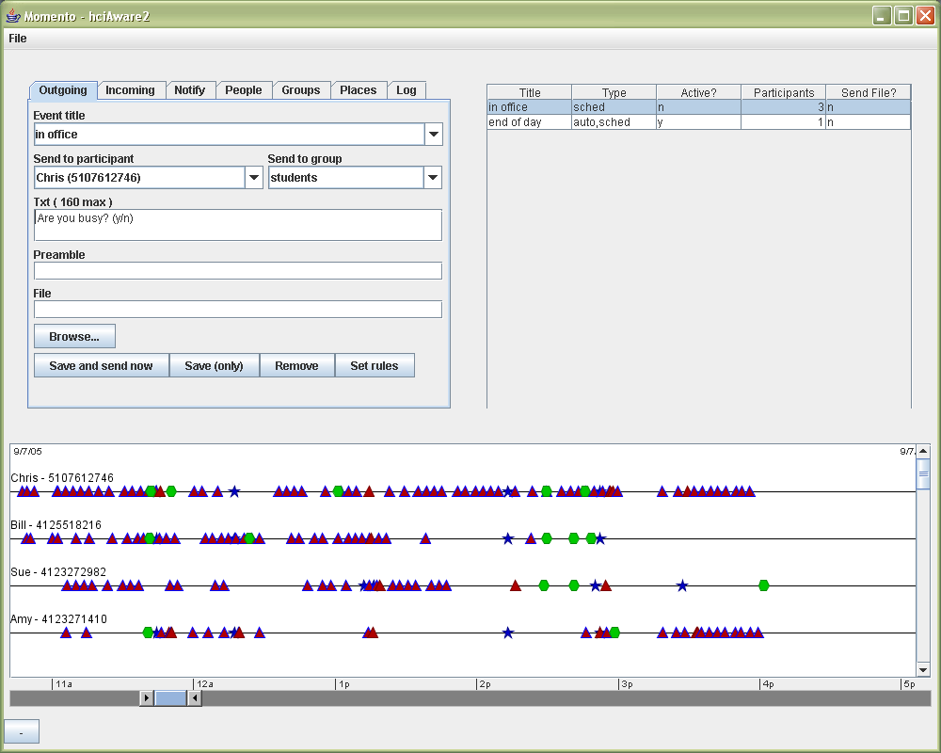
Easy ways to communicate with and study users
Easy setup for studies
Carter, Mankoff

Slide 59
Rule-based application design
If [cond and/or cond …]
Then send [content] to [recipient(s)]
Carter, Mankoff
Notes:
Experimenters can also use a simple rule system to automate feedback or to send notifications to participants throughout the day.

Slide 60
Rules
If [9:30AM]
Then send [“Remember to diary today”]
to [all]
Carter, Mankoff
Notes:
Experimenters can also use a simple rule system to automate feedback or to send notifications to participants throughout the day.

Slide 61
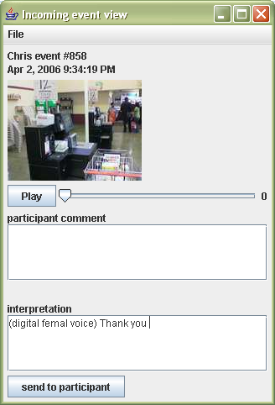
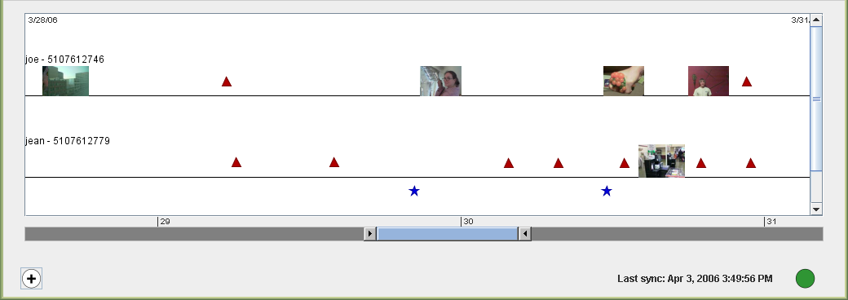
Support for Wizard-of-Oz
Easy setup for wizarding
Peripheral display for wizards
Carter, Mankoff
Notes:
Lets you monitor and respond to incoming events

Slide 62
Supports many forms of need-gathering
Diary & ESM
WOz
Mixed methods
Context-based mobile games and services
Data collection
Carter, Mankoff
Notes:
With this infrastructure, Momento can support a broad array of studies.
…
For example, the rule system can also be used to implement location and proximity sensitive mobile-based games and other applications.

Slide 63
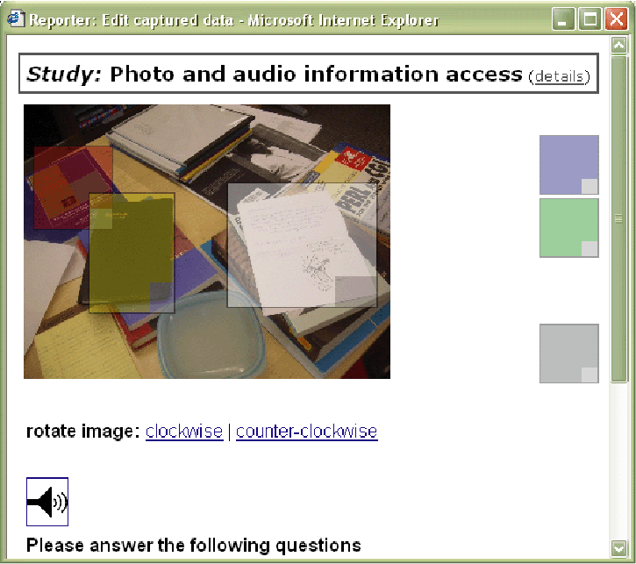
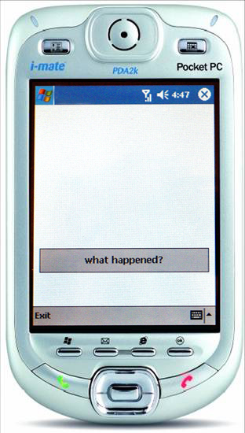
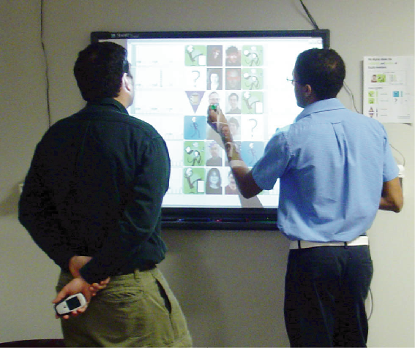
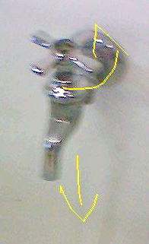
Validation
Informal learning
Scribe4Me
12 users
7 days
6 users
1-2 weeks
Photo Sketch
ESM study
24 users
1 day
14 users
2 months
Carter, Mankoff
Notes:
Usable/lowers floor:
“Developing” Scribe4Me: 3 configuration actions
Testing Scribe4Me: 3 configuration actions
Successfully supports evaluation
4 studies
2 weeks to 3 months in length
Varying levels of involvement by our team

Slide 64
Validation
Informal learning
Scribe4Me
12 users
7 days
6 users
1-2 weeks
Photo Sketch
ESM study
24 users
1 day
14 users
2 months
Carter, Mankoff
Notes:
Usable/lowers floor:
“Developing” Scribe4Me: 3 configuration actions
Testing Scribe4Me: 3 configuration actions
Successfully supports evaluation
4 studies
2 weeks to 3 months in length
Varying levels of involvement by our team

Slide 65
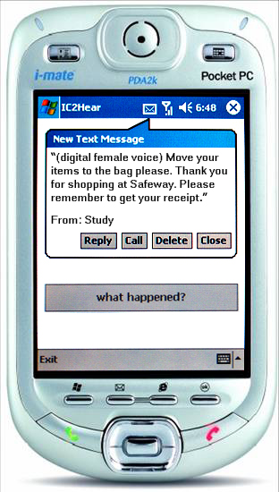
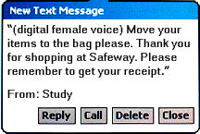
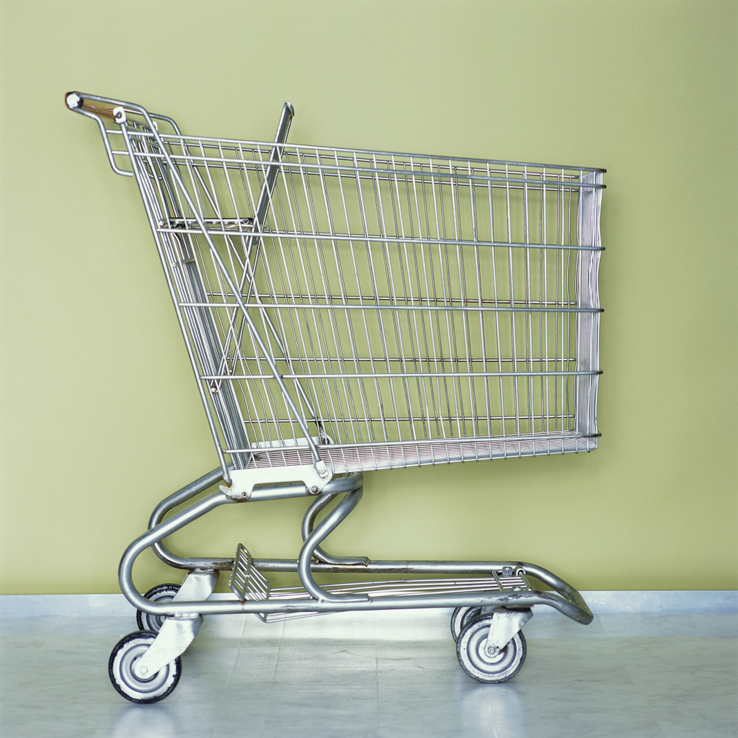
Scribe4Me System [Ubicomp’06]
Provides text transcriptions of the last 30 seconds of audio, upon user request
Conducted pilots and two week field study
Matthews, Carter, Mankoff
Notes:
Audio provides cues about
What’s going on around you
Problems (car, leaky faucet, etc.)
Alarms, alerts, the unexpected
Existing technology for the deaf is typically
Not mobile
Specific to a subset of sounds
Momento Mobile Client [Carter ‘06] to capture & transmit audio
Users asked to take a photo with requests
Sends two 15-second WAV files (8KHz mono, 115 kb each)
2-4 minutes to transmit via GPRS
Devices: I-mate PDA2K, Windows Mobile system

Slide 66
Scribe4Me Field Study
Participants 6, varied hearing
Method 2 week study, Daily email diary
Results
Many aspects of sound interesting
Speech
Gender and emotion
Environmental audio (info about volume; location; or id)
Historical information valuable
Mobile tools need to address informed consent
Matthews, Carter, Mankoff
Notes:
Study: [read]… Due to some scheduling problems, hardware issues, and network connectivity problems, users ended up completing between 7 and 15 days of the study (7, 8, 10, 13, 14, 15).
Participants – hearing: [read]… 3 had some hearing with aids or cochlear implants, which they used during the study.
Data - Diary: Users completed a daily email diary. We ask questions about each request, like why did you make the request, how useful was the response, and could it have been improved (where were you, which request today was most important to you and why)?
Requests: for each request, we have the audio, a photo, and a transcription. I am going to play for you an example of some audio requests we received, which will give you a sense for the quality and the types of situations people used the tool. I am avoiding audio that includes conversations for privacy reasons.
- grocery, airport

